Slide 1

GITHUB PROFILE
Promoting your skill & Employability

Slide 2
When it comes to your GitHub profile, it's essential to strike a balance between showcasing your skills, projects, and contributions while maintaining professionalism and privacy.

Slide 3

Does your GitHub present you as a real professional person or a Bot?

Slide 4
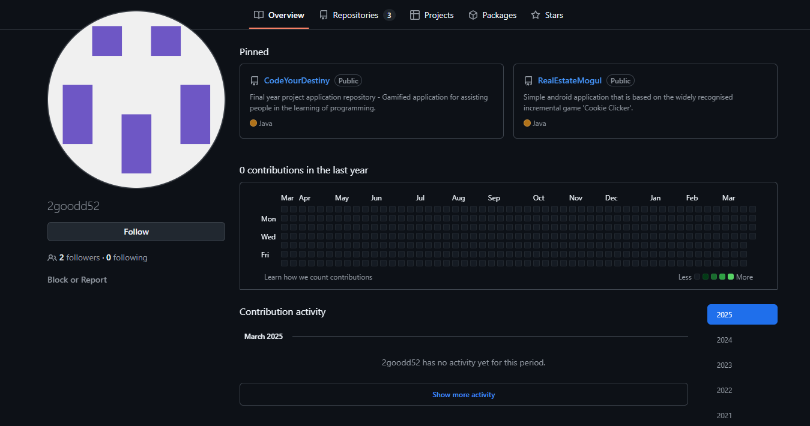

Slide 5
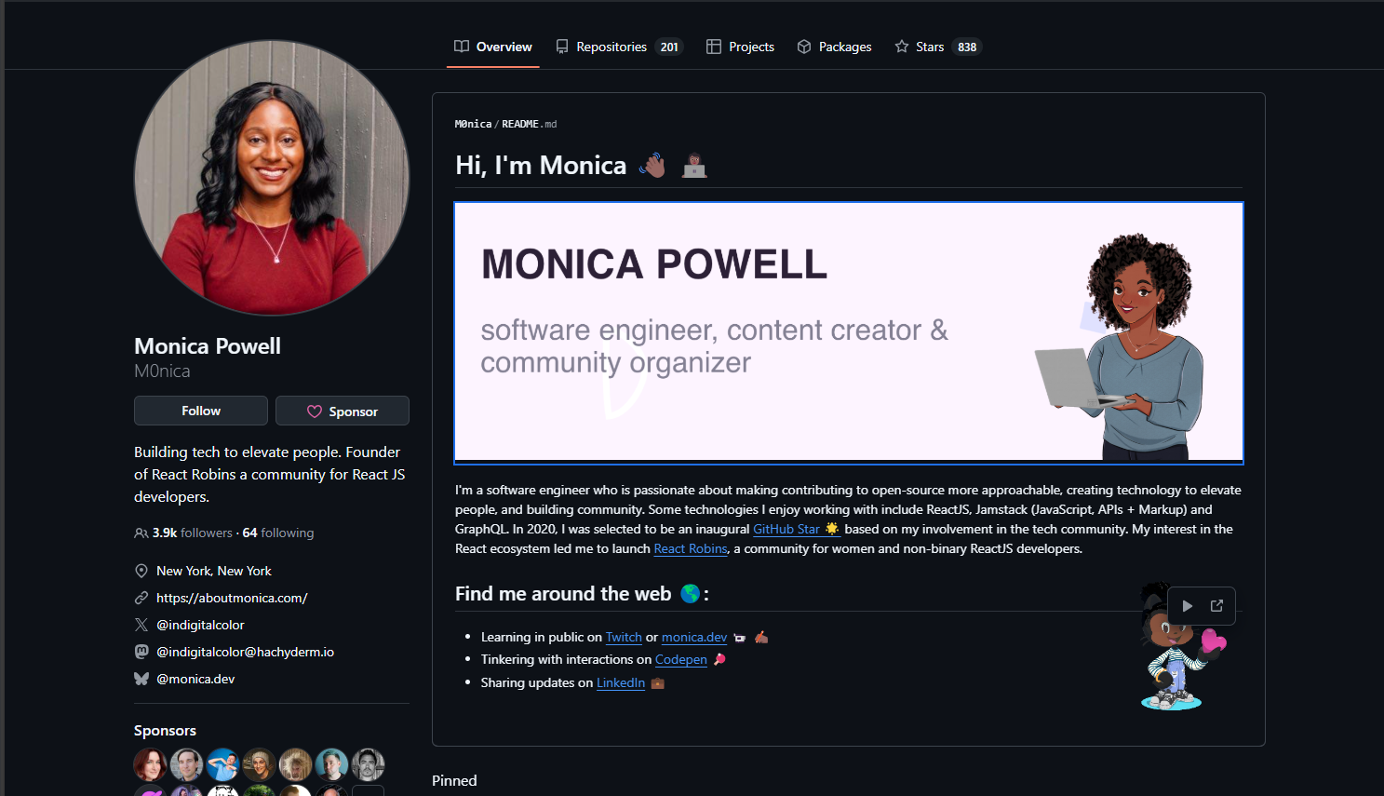

Slide 6
Do:
Professional Profile Picture: Use a professional photo or avatar that represents you well in a work context.
Bio/Description: Write a brief, informative bio that highlights your expertise, interests, and contributions. Keep it concise and relevant.
Repositories: Publicly showcase your best projects, contributions, and code samples. Organise them with clear descriptions and README files.
Contributions: Highlight your contributions to open-source projects and collaborations. This demonstrates your engagement and expertise within the developer community.

Slide 7
Do:
Skills: Include a list of relevant skills and technologies you're proficient in. This helps others quickly assess your expertise.
Contact Information: Optionally, provide ways for others to reach out to you, such as an email address or social media profiles.
Open-Source Contributions: Mention any open-source projects you maintain or actively contribute to. This showcases your commitment to collaboration and community building.

Slide 8
Don't:
Sensitive Information: Avoid including sensitive personal information such as your home address, phone number, or personal email address.
Confidential Code: Do nOt from uploading proprietary or confidential code to public repositories. Be mindful of intellectual property rights and confidentiality agreements.
Incomplete or Untidy Repositories: Keep your repositories organised and well-documented. Avoid leaving unfinished or messy projects on your profile.
Unprofessional Content: Refrain from sharing content that could be considered offensive, discriminatory, or unprofessional. Remember that your GitHub profile is a reflection of your professional image.

Slide 9
Don’t
Overly Personal Details: While it's fine to mention hobbies or interests, avoid oversharing personal details that are unrelated to your professional profile.
Negative Remarks: Avoid making negative remarks about previous employers, colleagues, or projects. Maintain a positive and constructive tone in your interactions and contributions.
Inactive or Outdated Content: Regularly update your profile with recent projects and contributions. Avoid leaving outdated or inactive content that doesn't reflect your current skills and expertise.

Slide 10
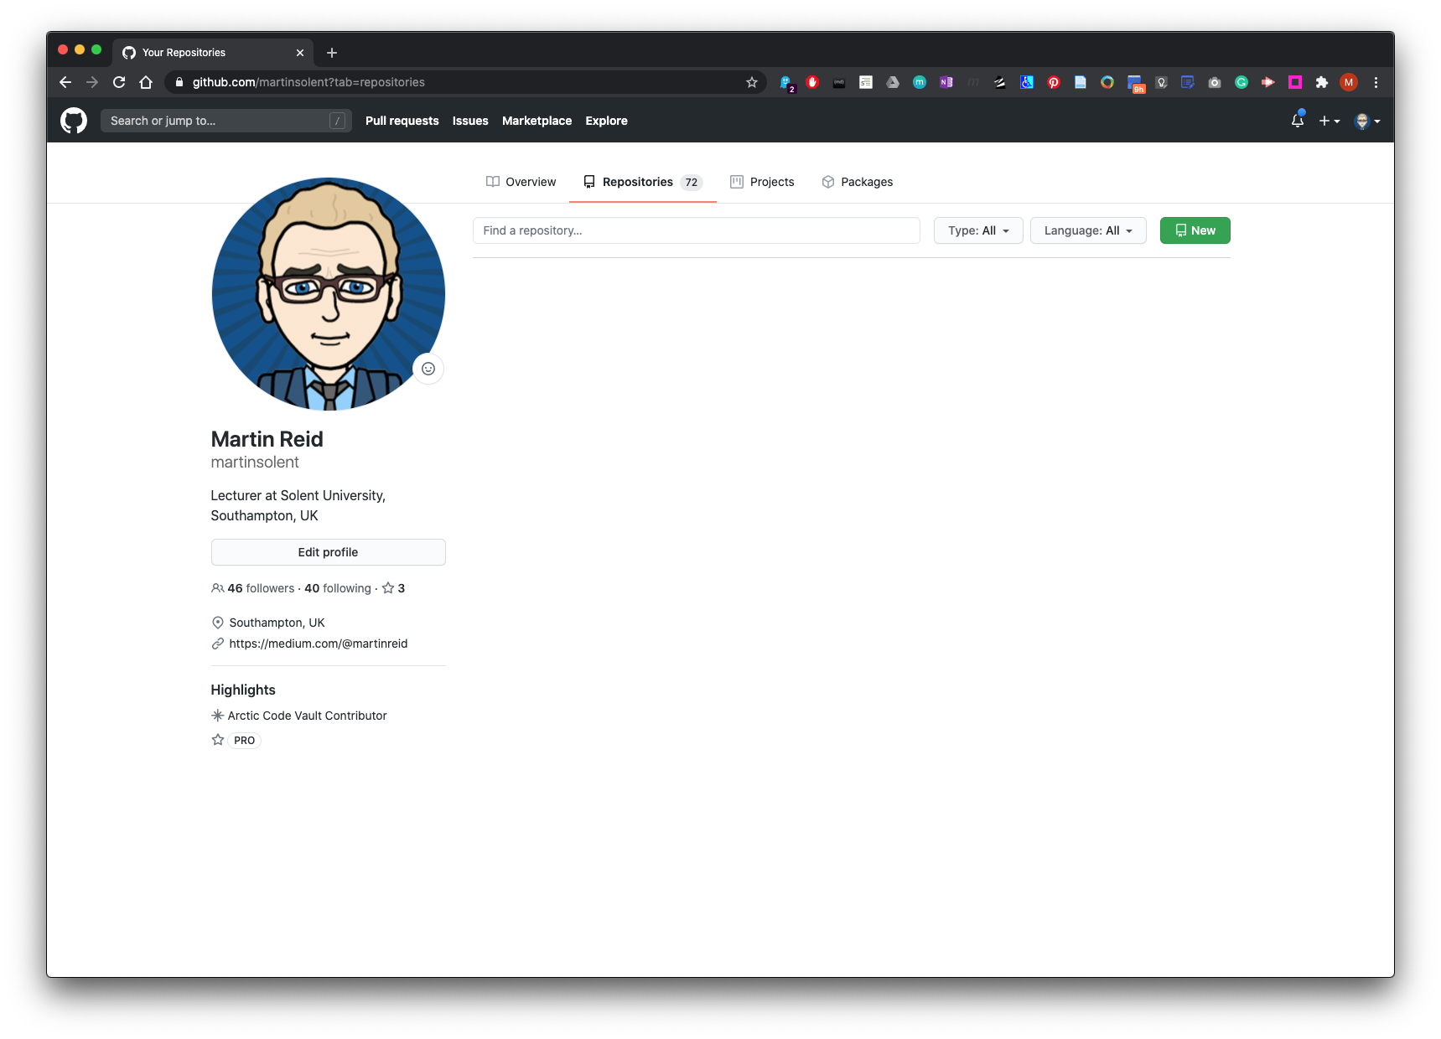
How to create a main profile README in GitHub - Create a new repository:

Slide 11
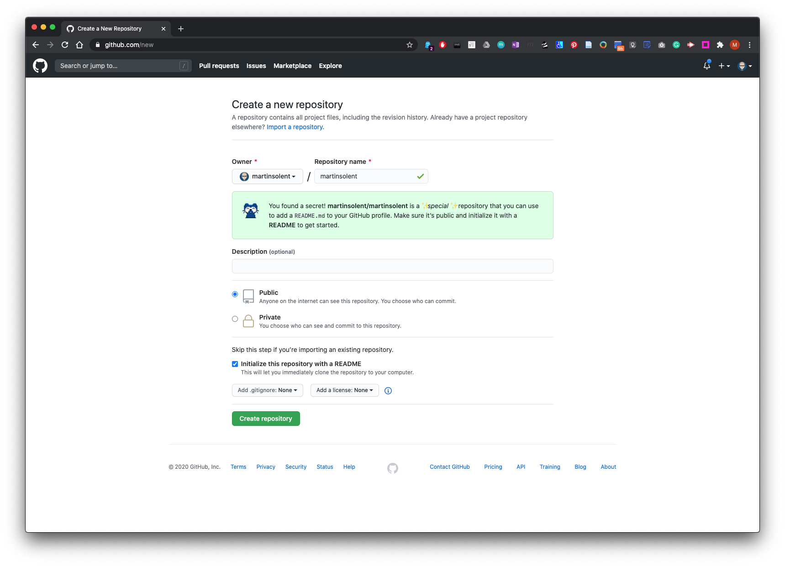
Name this repo the same name as you GitHub Profile (remember this is case sensitive) Make sure you check the Initialise this repository with a README. Then click create repository.

Slide 12
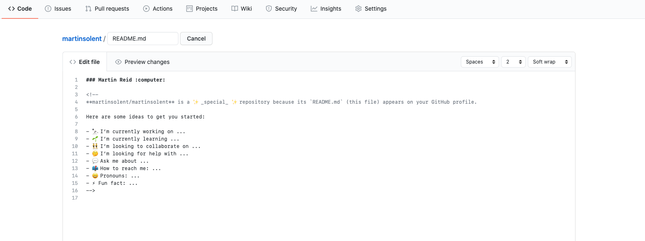
Edit and update as you see fit such as add a promo banner, GitHub offers you some pre-populated details which are commented out to get you started.

Slide 13
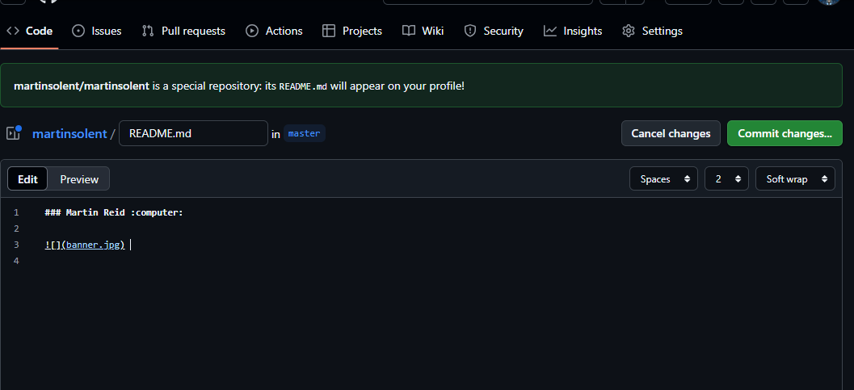
Name and commit changes

Slide 14
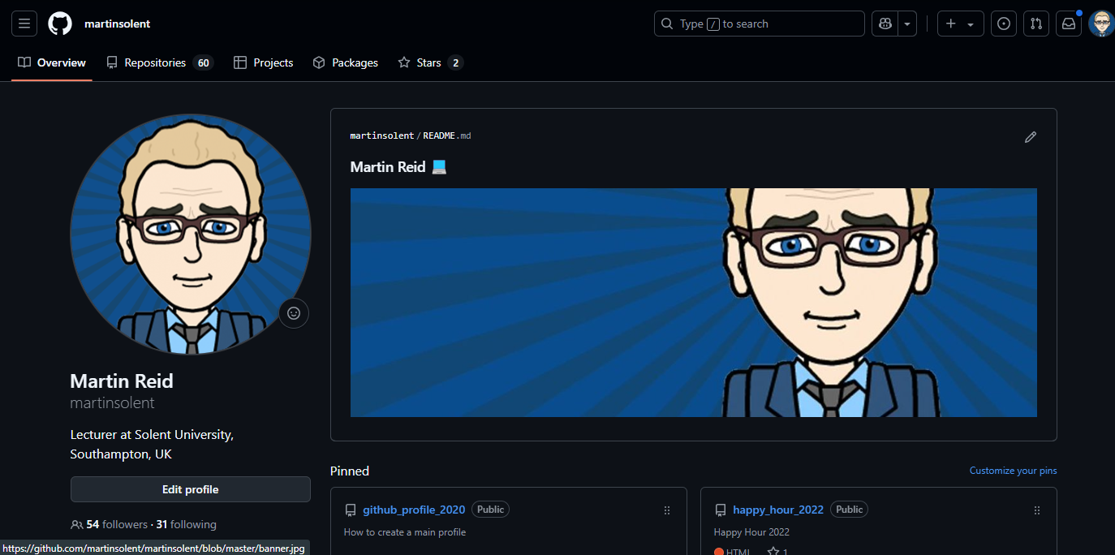

Slide 15
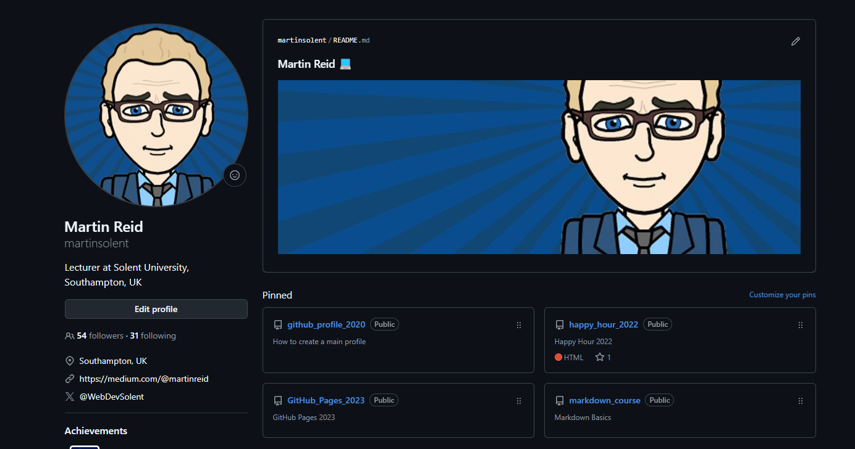

Slide 16
Thank You

